Slide 1
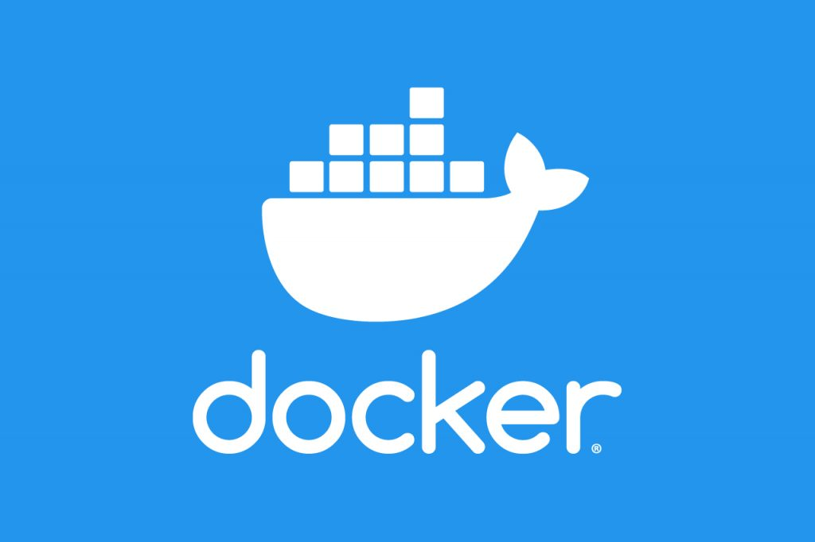
EC2 Instance & Docker Installation
By: Justin Vargas, Luis Ventura, Quatecha Cleveland Webb, Edgardo Vasquez, J R, D’Andre Walden

Slide 2
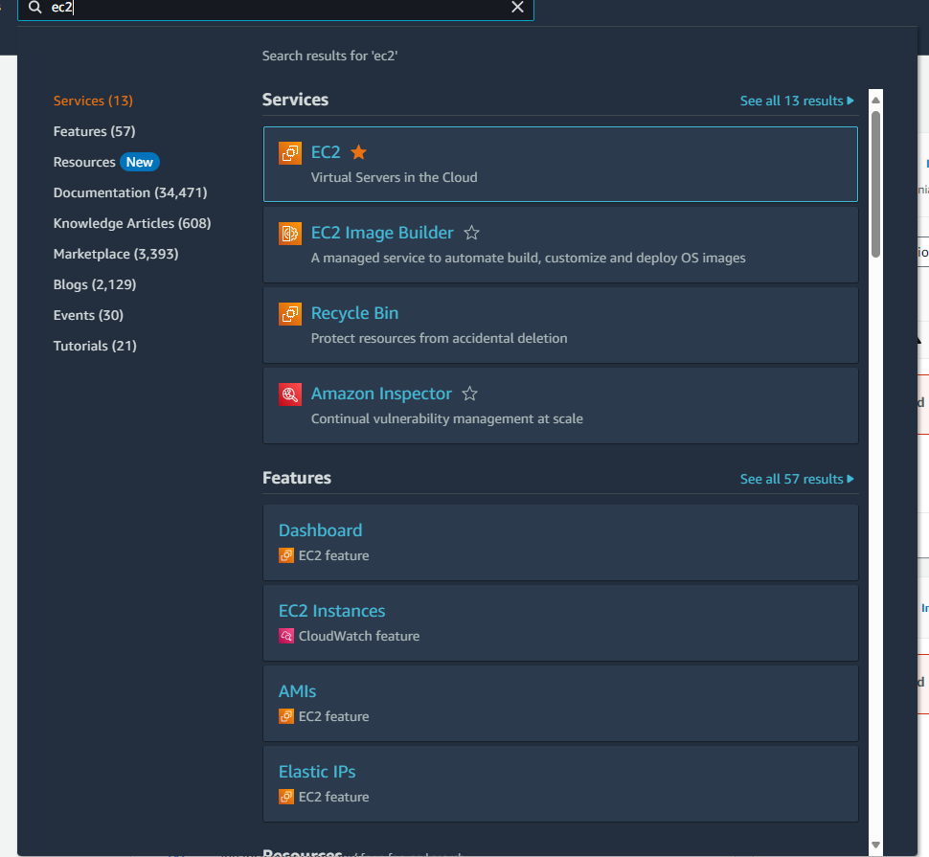
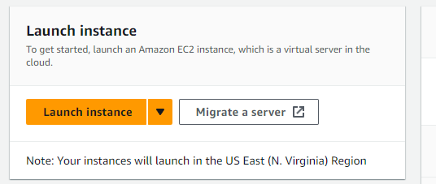
Launching Your EC2 Instance
Go to the search bar from the console and type in “EC2”, then click on Launch Instance.

Slide 3

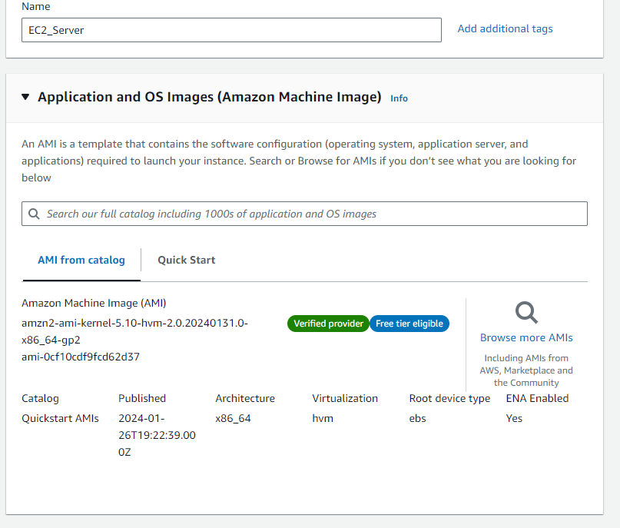
Naming Your Instance
Name your instance called “ec2-server”

Slide 4

Choosing an Amazon Machine Image (AMI)
Choose amazon linux 2 as your AMI

Slide 5

Choosing an Instance Type
Type in t2.micro as your instance type

Slide 6

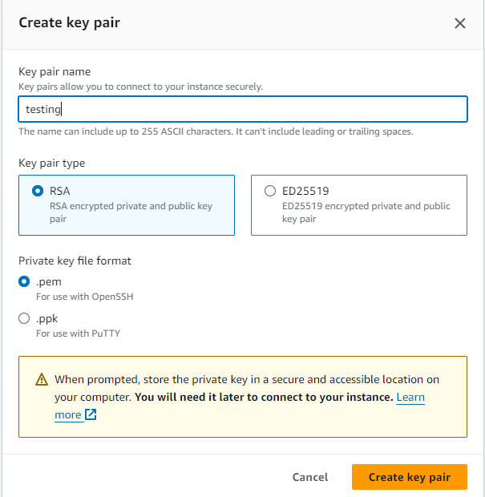
Configuring a Key Pair
Create a key pair and name it
Choose RSA as your key pair type
Choose .pem as your private key format

Slide 7
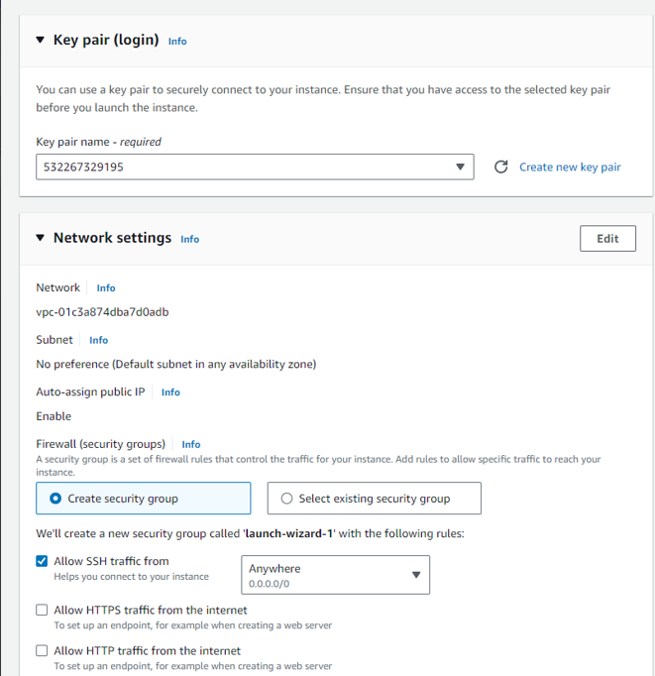

Configuring the Network Settings
From the firewall option, select “Create security group”
Put a check mark on “Allow SSH traffic from”

Slide 8


Launch Instance
Once everything is completely setup, you can click on “launch instance”

Slide 9
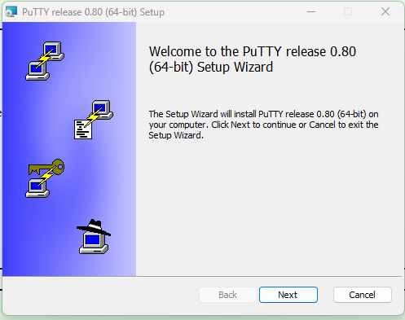
HOW TO INSTALL PUTTY
PuTTY is a free and open-source terminal emulator, serial console, and network file transfer application.
PuTTY acts as a terminal emulator, allowing users to interact with remote systems using various network protocols.

Slide 10
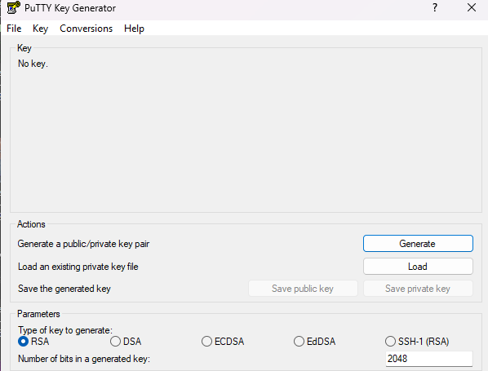
LOAD A PRIVATE KEY PAIR
In the PuTTYgen window, click “Load”.
Locate and select your private key file (usually with a .ppk extension).
Click “Open”.

Slide 11
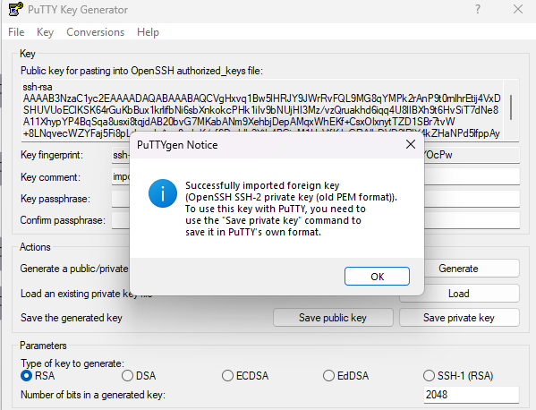
SUCCESSFULLY LOADED KEY PAIR
The private key should now be loaded in PuTTYgen.
You’ll see details about the key, including its type
You can now use this private key for SSH authentication.

Slide 12
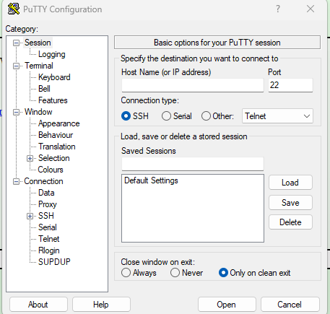
PUTTY CONFIGURATION
Open Putty:
In the PuTTY Configuration window, you’ll see various settings on the left.
The main section is “Session” (which is where you’ll enter your IP address)
Enter IP address:
In the “host name (or IP address)” field, type your IP address
If you’re connecting via SSH, make sure the “SSH” protocol is selected.

Slide 13
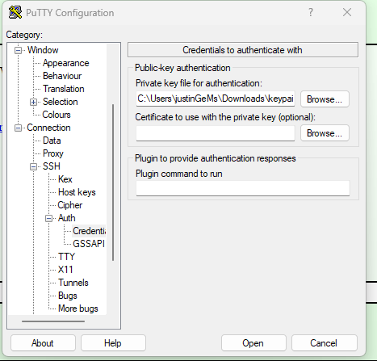
CONFIGURE AUTHENTICATION
Go to “Connection” > “SSH” > “Auth”.
Click “Browse” and select your private key file (usually with a .ppk extension).
Click “Open” button at the bottom of the window.
PuTTY will attempt to connect to the specified server using the provided settings.

Slide 14
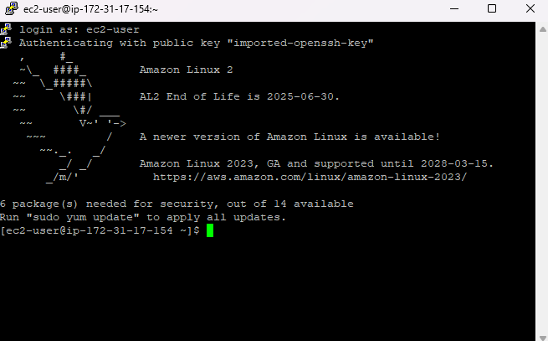
TERMINAL SUCCESSFULLY OPENED!

Slide 15
How to Install Docker on the EC2 Instance?
Before installing Docker, you should update the package index by typing this command into your command line or terminal
sudo yum update -y

Slide 16

Installing Docker
To install Docker on Amazon Linux, you can use the following command:
sudo yum install docker -y

Slide 17
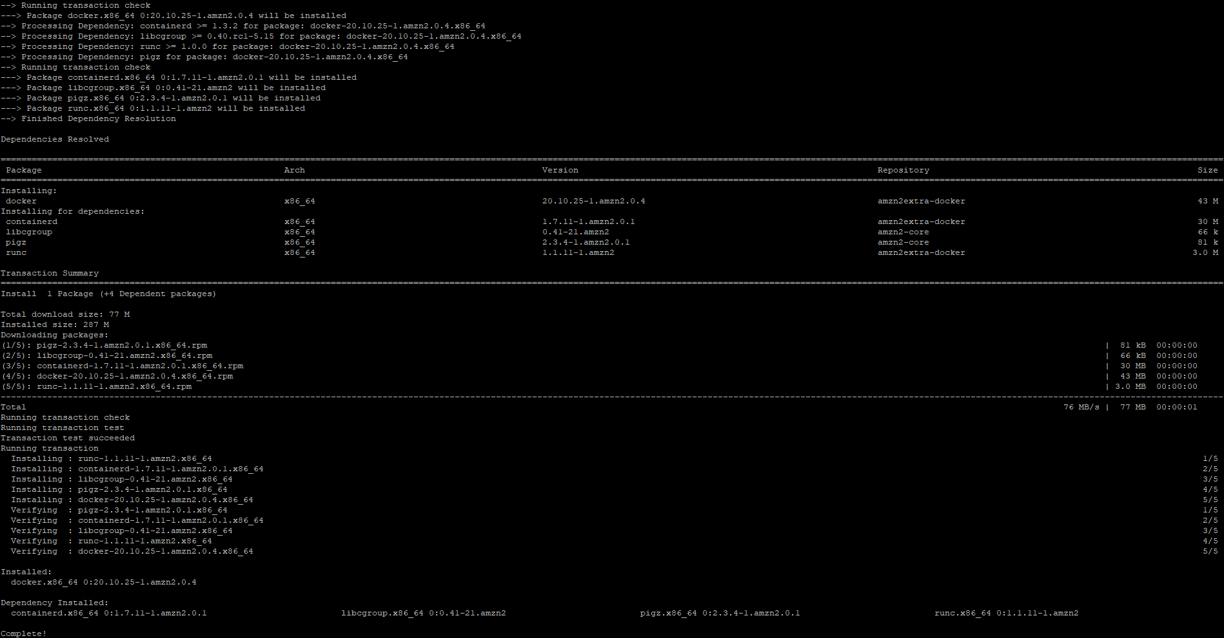
What it looks like to install Docker

Slide 18
Starting the Docker Service
After installing Docker, you will need to start the Docker service:
sudo systemctl start docker

Slide 19
Verifying the Installation
Once you have started the Docker service, you can verify that it is running by running the following command in your terminal:
sudo docker run hello-world

Slide 20

Enabling the Docker Service
To start the Docker service automatically when the instance starts, you can use the following command:
sudo systemctl enable docker

Slide 21

Check the Docker Version
Verify the Docker installation by running the Docker version command:
docker --version

Slide 22
Add user to Docker Group
(Optional) Add your user to the Docker group to run Docker commands without 'sudo'
sudo usermod -a -G docker $(whoami)
After executing this command, the user will be added to the docker group and will have the necessary permissions to run Docker commands without sudo.

Slide 23
Note
Note that the change to the user’s group membership will not take effect until the next time the user logs in. You can log out and log back in to apply the changes or use the following command to activate the changes without logging out:
newgrp docker

Slide 24
Conclusion
Installing Docker on the amazon linux is a simple process that requires only a few steps, By following these steps. By following these steps, you should be able to install docker and start using it to build, ship, and run your applications on your Amazon Linux Instance.

